Slide 1
Highlights of The Phoenix Centre taster week

Slide 2
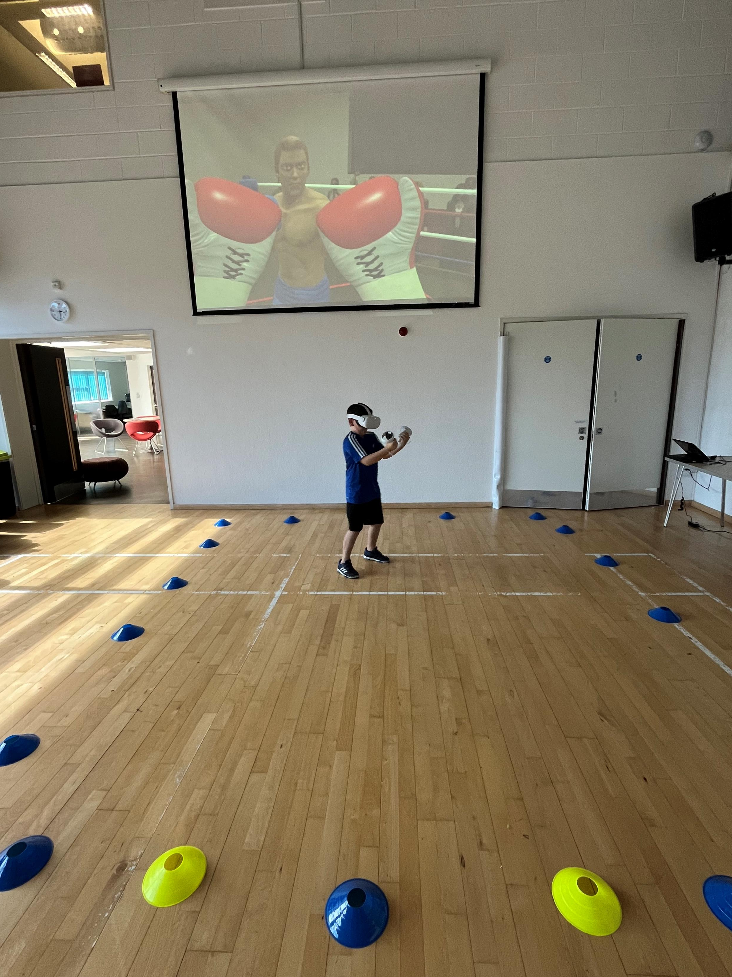
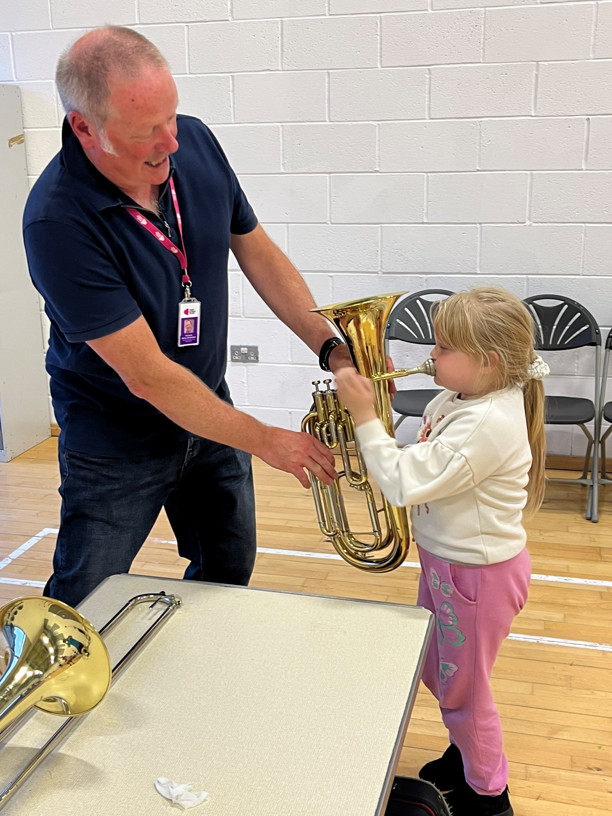
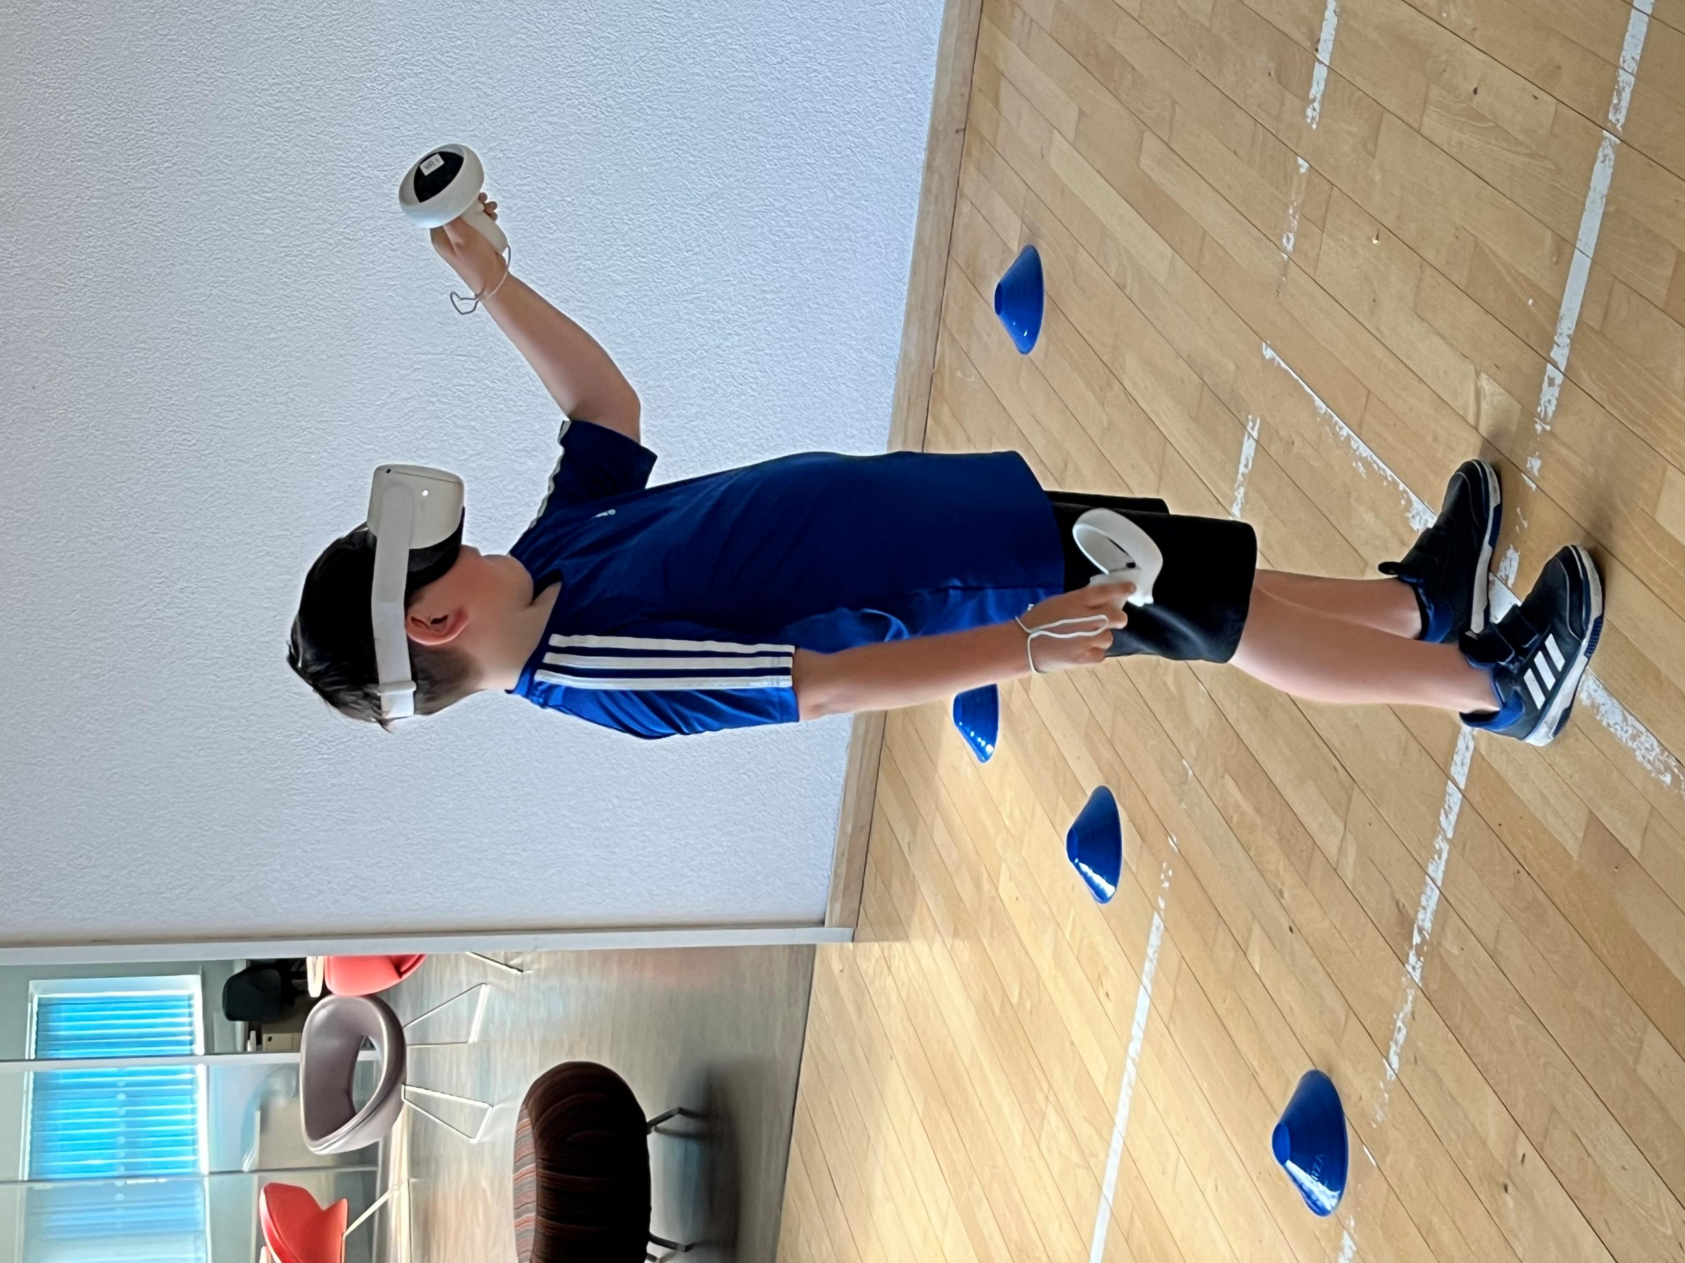
14 teenagers attended the VR gaming session, and 25 children came to try an instrument.
For many was a first-time experience!

Slide 3
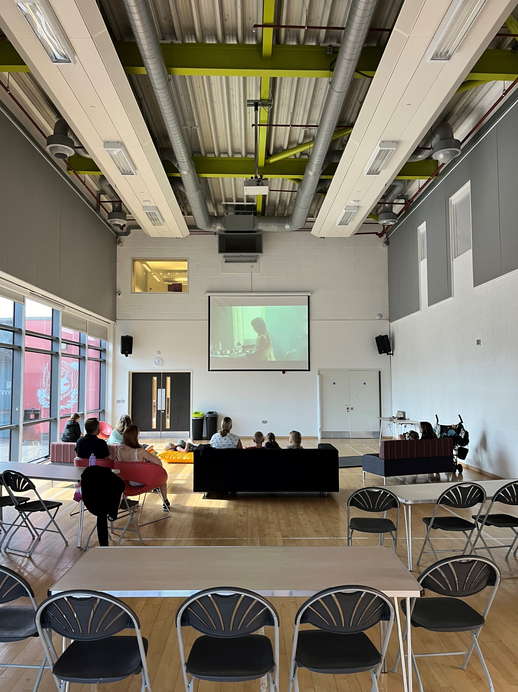
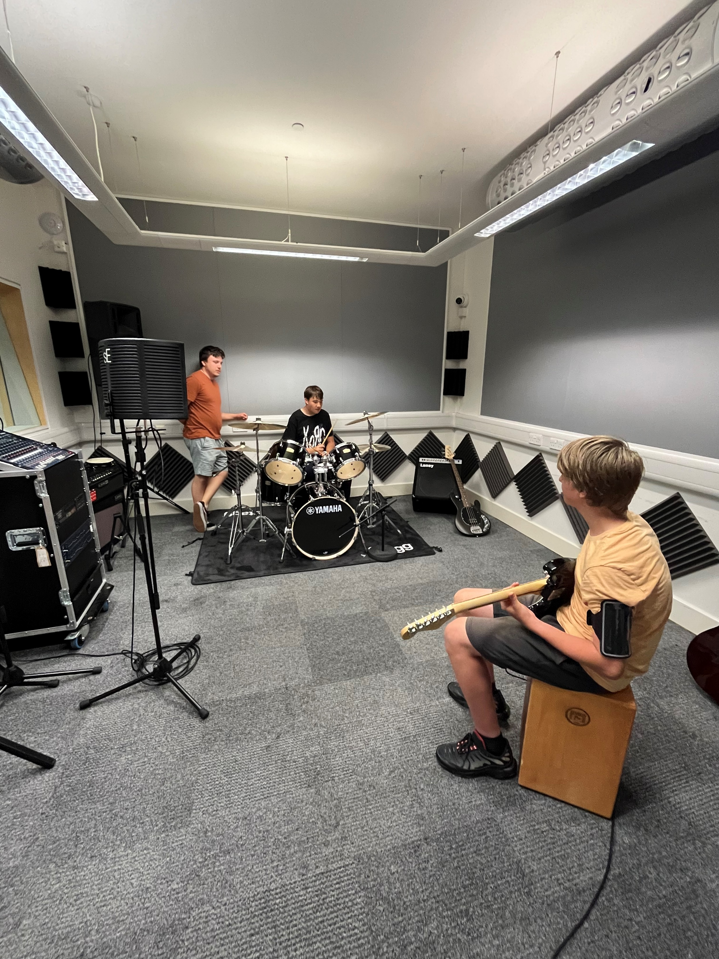
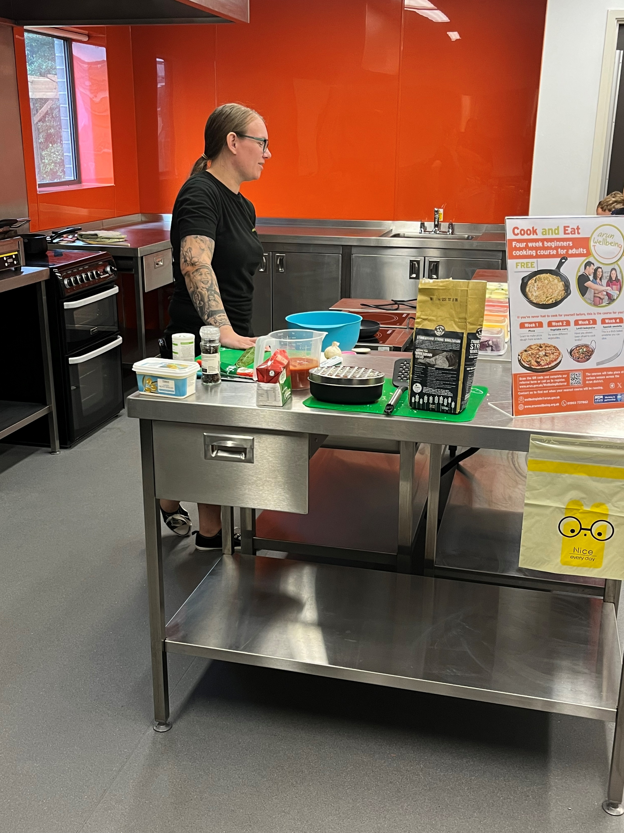
5 families attended our film night and 3 families to our healthy cooking session.
“It was so great to have this relaxed environment for my child to watch a film in this kind of setting, with his needs I can’t take him to the cinema”

Slide 4
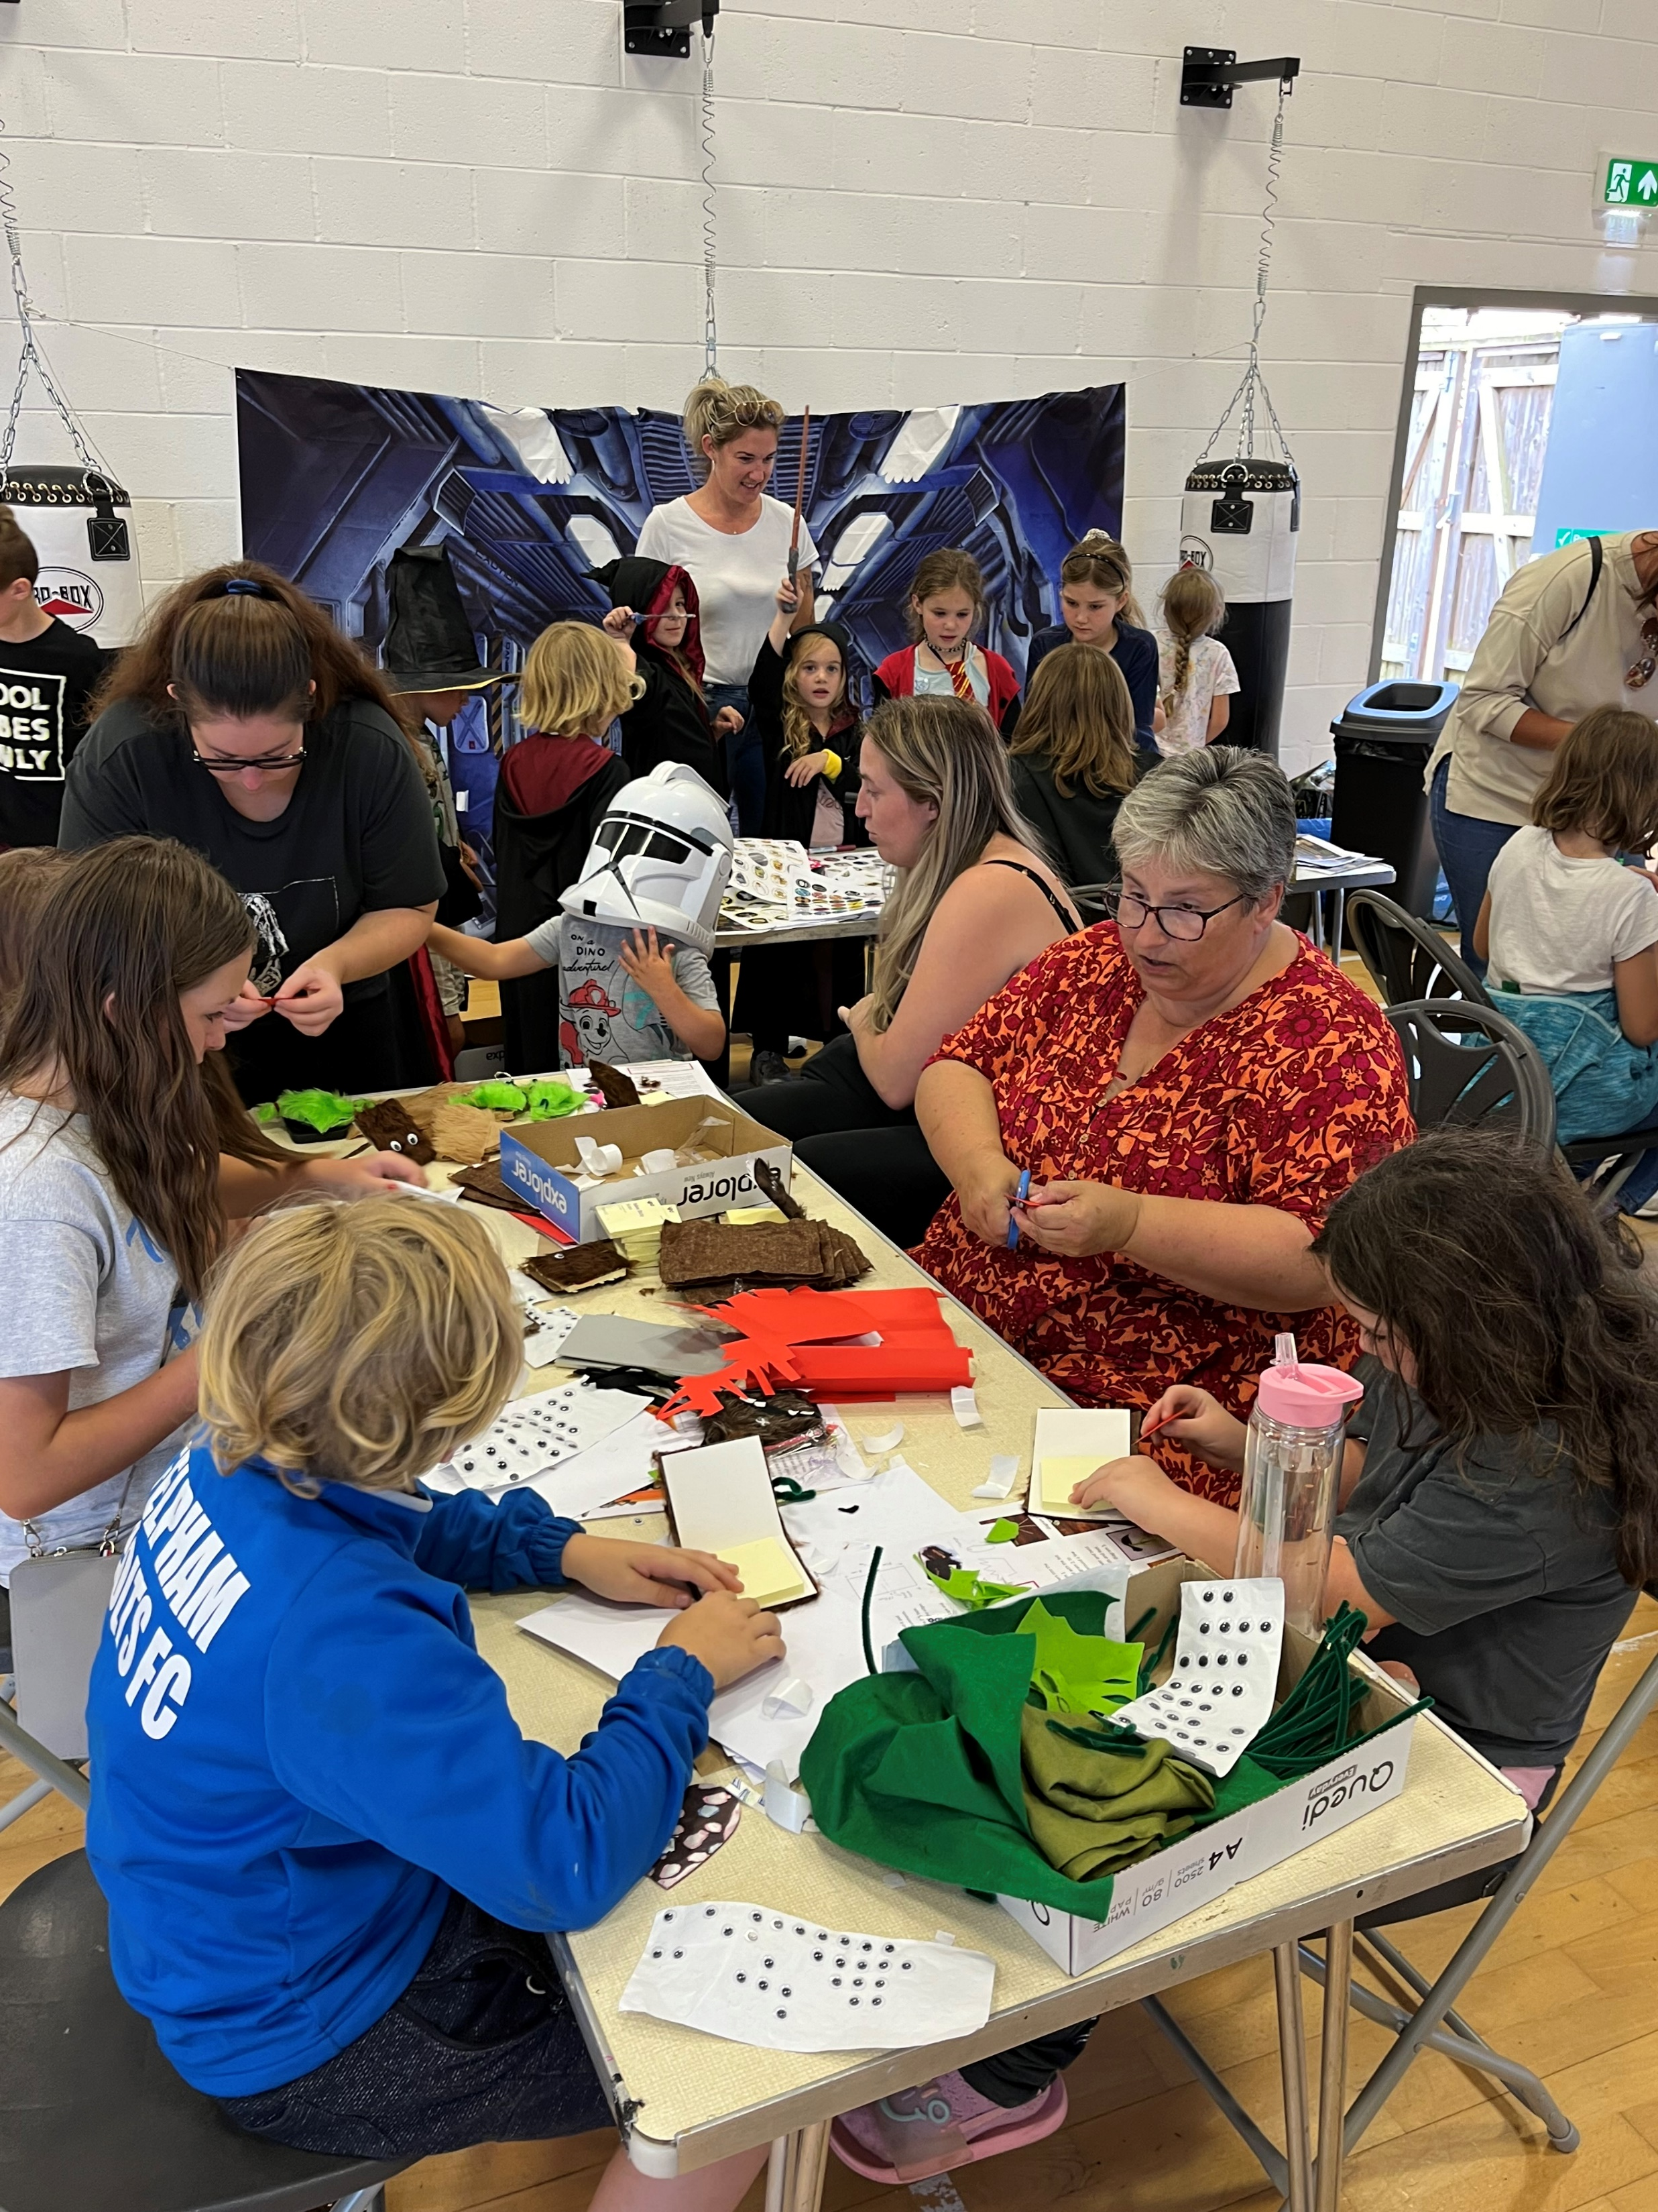
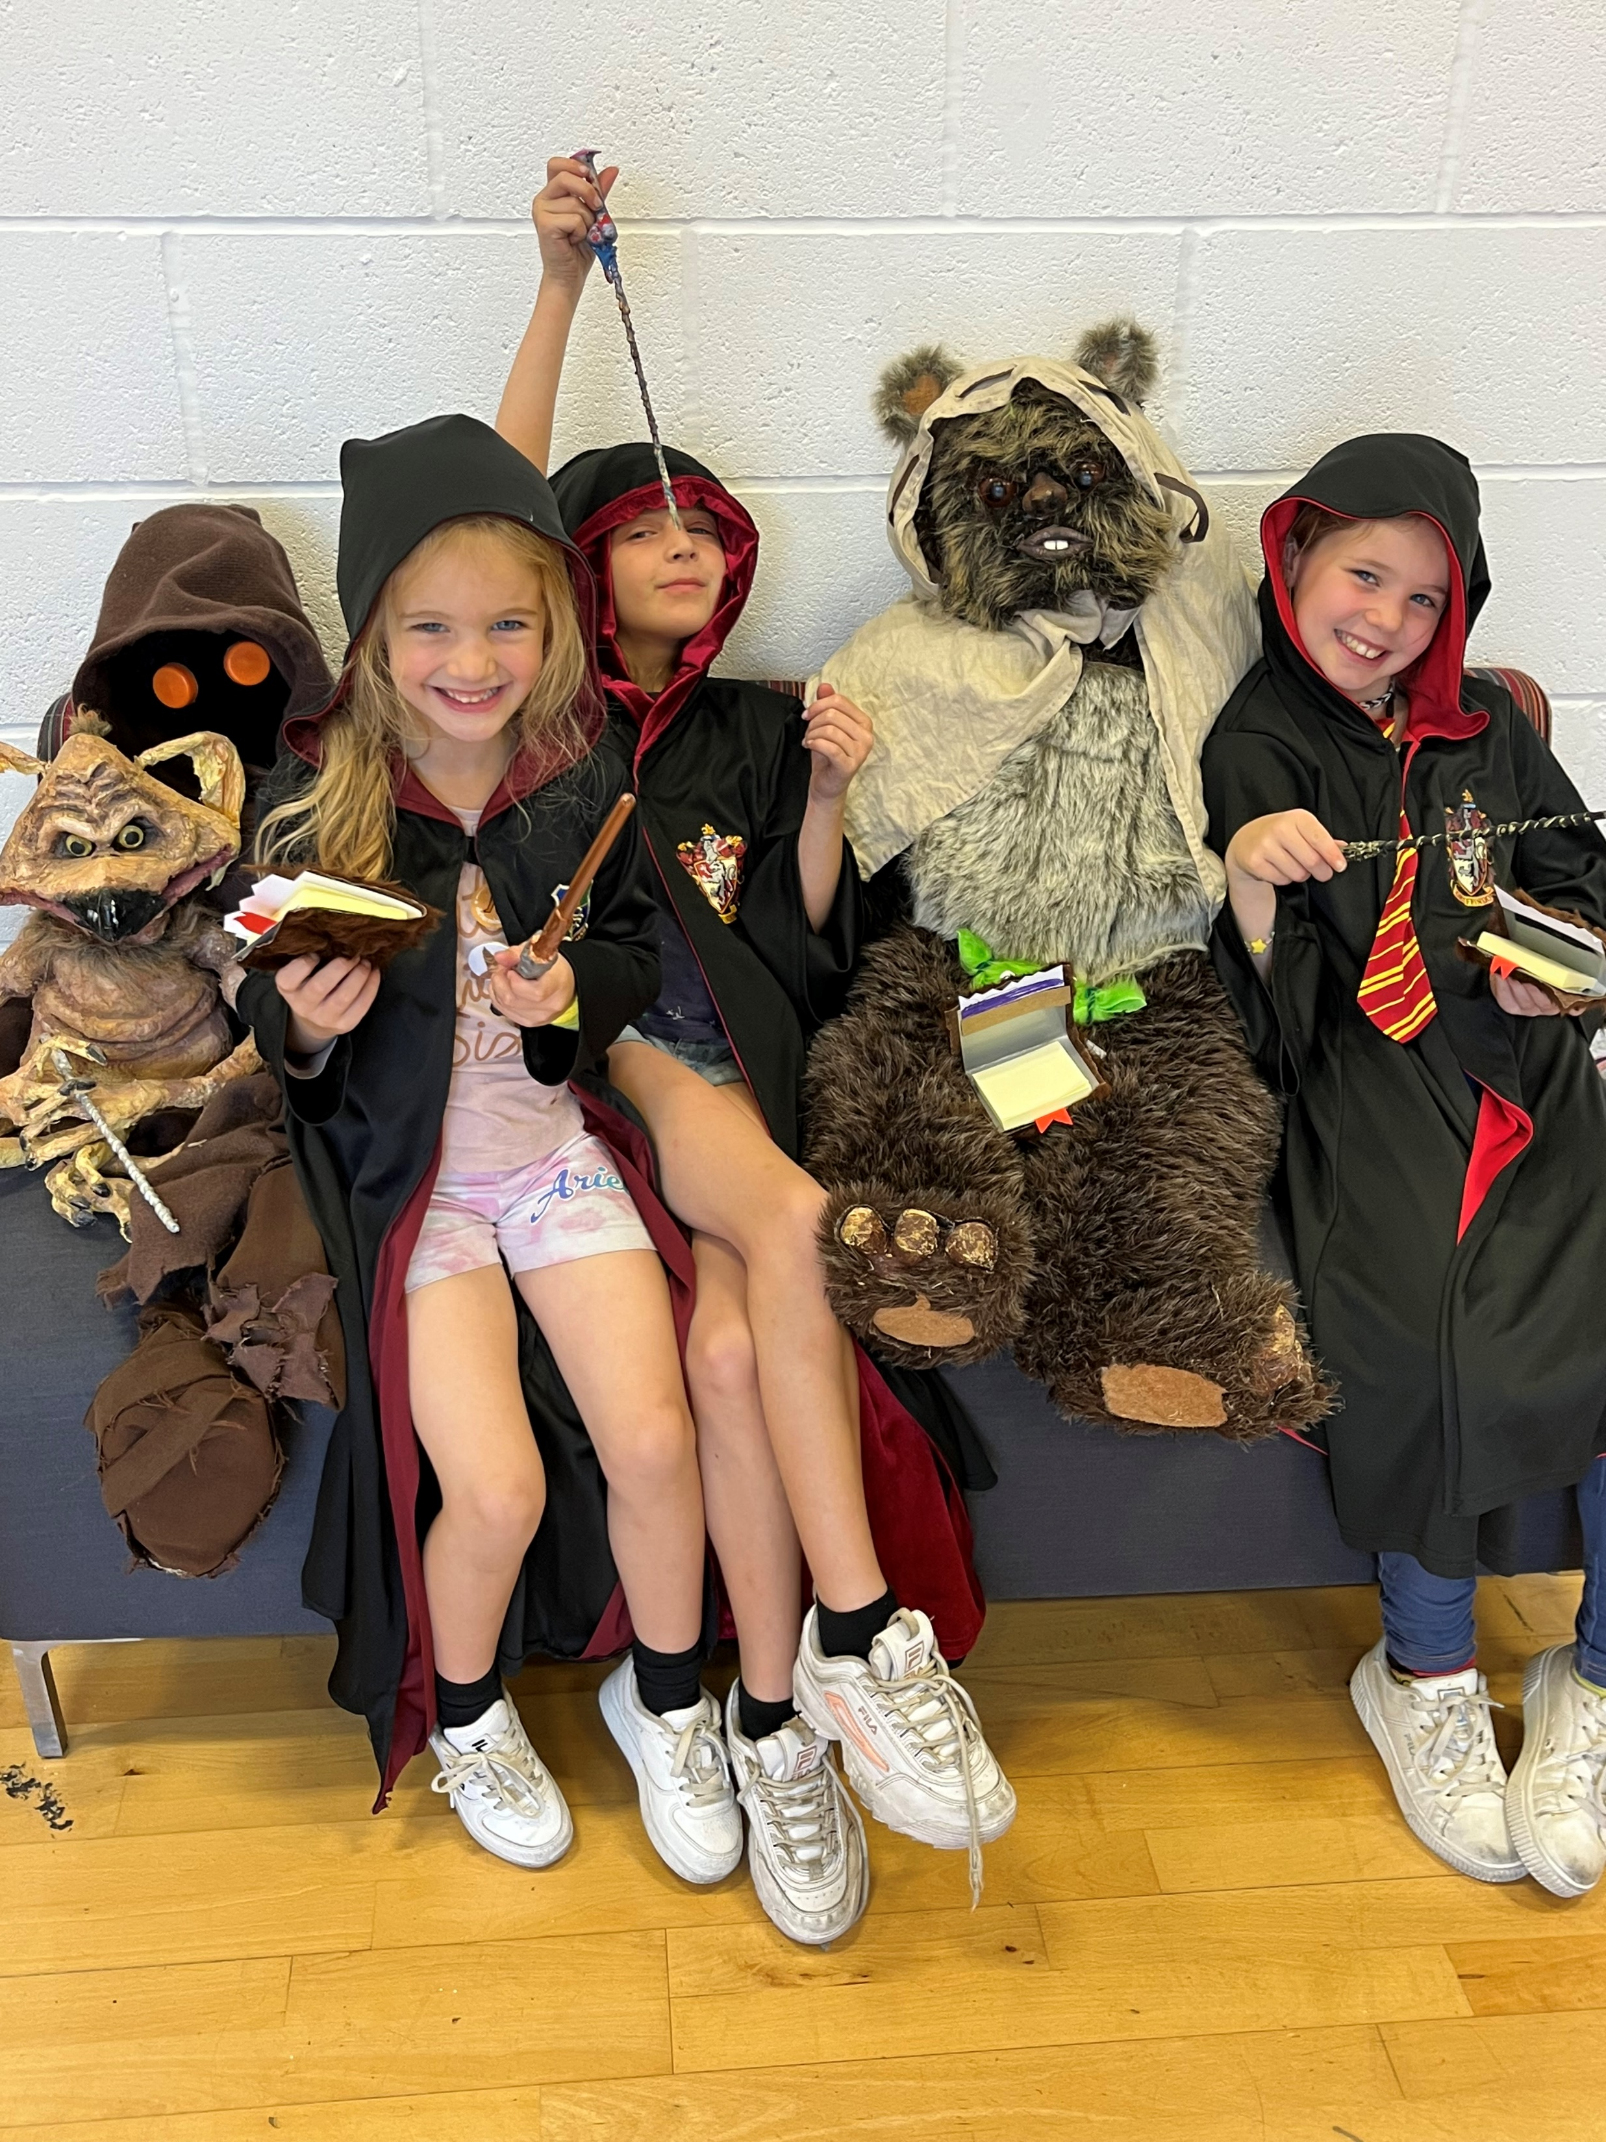
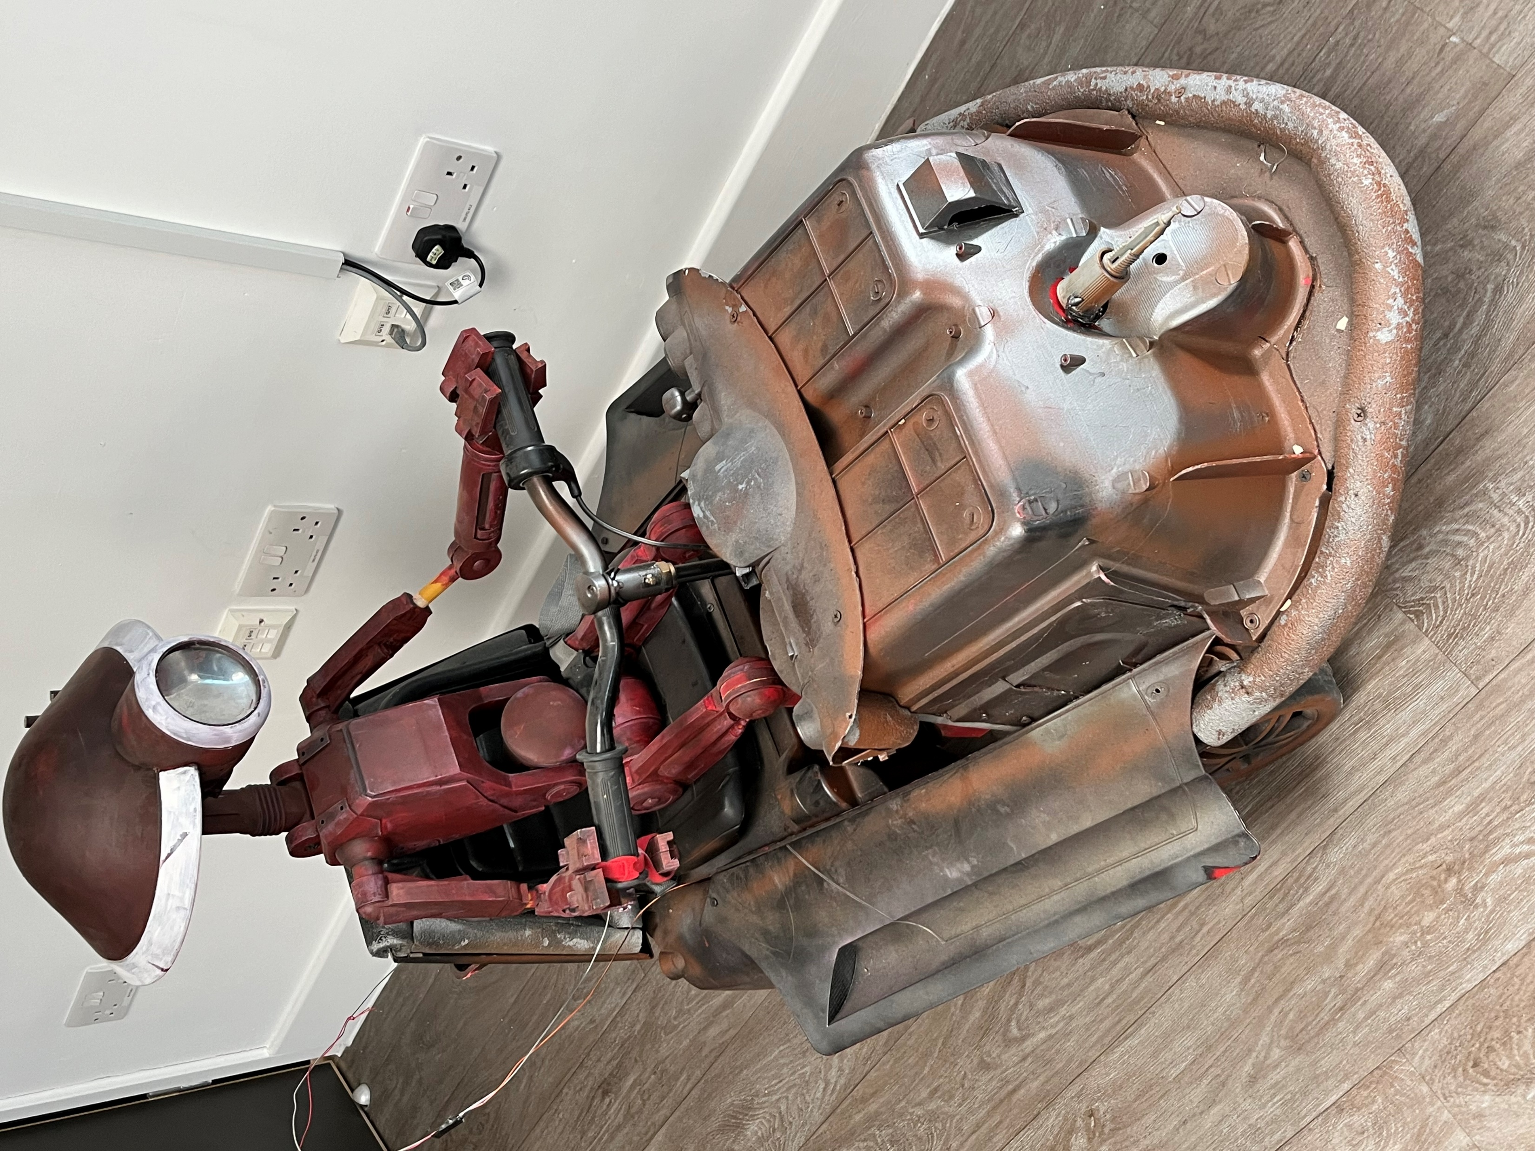
We had approximately 60 children attend the Harry Potter & Star Wars arts and crafts session!

Slide 5
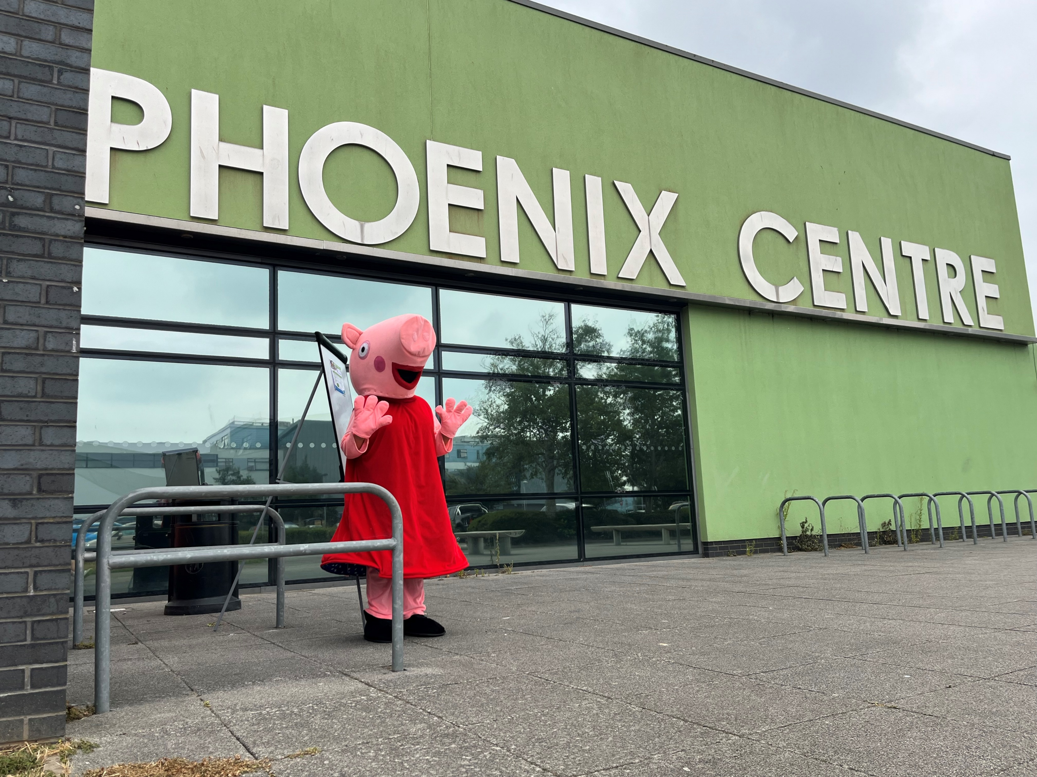
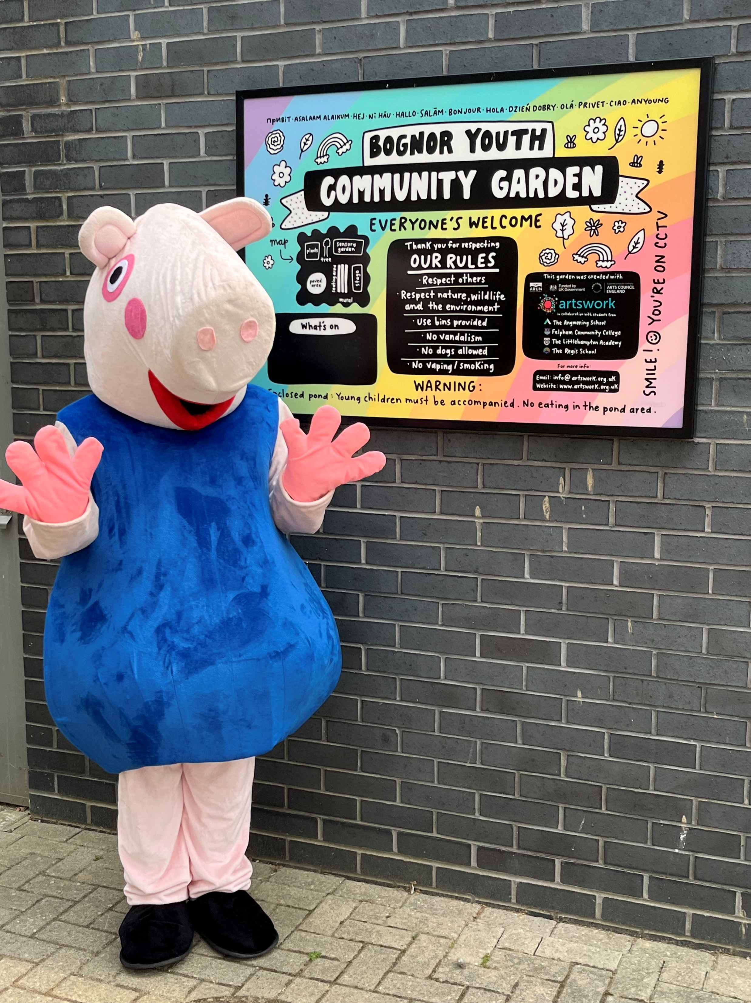
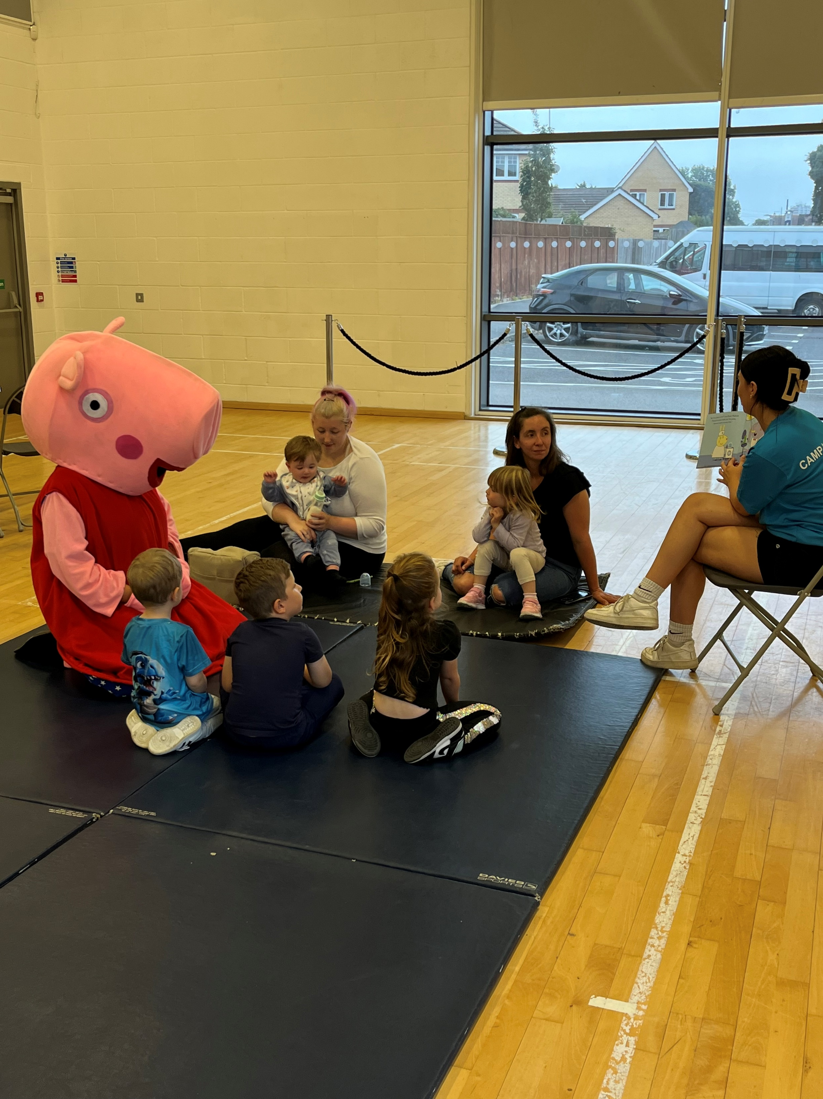
We had two special guests visit the centre and get involved with the family reading session, with collaborative donations from the local library.

Slide 6
Our holiday and activities funded summer camp children were able to enjoy
a boxing session and meet Peppa Pig!

Slide 7
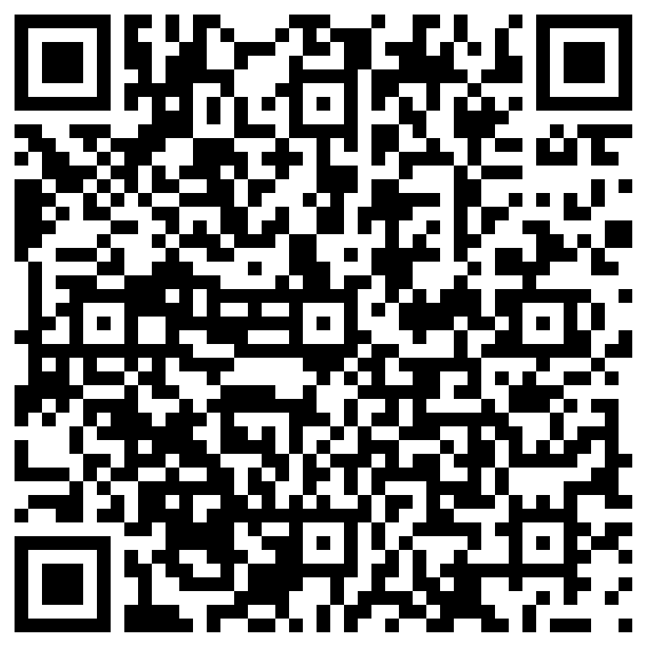
We used a QR code to get community voice. This will now be shared publicly via social media to boost the data

